Slide 1
Shapley Values for Large Problems
2026 Sawtooth Research Conference
Berlin May 6, 2026
David W. Lyon
Principal
Aurora Market Modeling, LLC
DLyon@Aurora2000.com
9

Slide 2
The Plan
Shapley Values: Intro, intuition and meaning
Component Order of Addition (COA) designs
Computation problems that COAs solve
Do COAs work?
Properties and issues
When Are Shapley Values Informative?
When do Shapley Values add information/value?
Size-Limited Shapley Values
TURF on MaxDiff – options, problems, evidence from SVs
Wrapping Up
Appendix: Design Catalog, Software and Timings

Slide 3
Datasets
Thank you to helpful colleagues who provided large datasets to test:
Anonymous
Tom Eagle
Marco Hoogerbrugge
Richard McCullough
Trevor Olsen
Cynthia Sahm
The author
See references for 2 publicly available datasets (“GSS” & “2K5”)

Slide 4
Shapley Values

Slide 5
Key Drivers
Suppose we have three independent variables in a regression
Euler diagram (Venn, but with meaningful sizes and areas)
What does each contribute?
What’s most important?
How do we quantify that?
2026 Sawtooth Research Conference Lyon: Shapley Values for Large Problems

Slide 6
Simple R²
Single independent’s correlation with dependent
“Ignores” overlap, so any total:
Double-counts overlaps
Or triple-counts
Or …
Or 19-counts
A big chunk of things is over-counted
2026 Sawtooth Research Conference Lyon: Shapley Values for Large Problems

Slide 7
Significance Testing
“Most important ones have most significant t-tests”
“(or F-tests)”
Those tests look at the unique contributions of each variable
Excluding overlap entirely
Big chunk of things gets ignored
2026 Sawtooth Research Conference Lyon: Shapley Values for Large Problems

Slide 8
Stepwise Additions
Full credit to the first in
Whatever the next one adds
What’s added by next, next …
Overlaps credited:
Entirely to early variables
Not at all to later ones
Unstable if order changes
Common when two are close across waves or subgroups
2026 Sawtooth Research Conference Lyon: Shapley Values for Large Problems

Slide 9
Order Matters
A different order changes results dramatically
2026 Sawtooth Research Conference Lyon: Shapley Values for Large Problems

Slide 10
Share the Overlap
“It’s only ‘fair’ to split the overlap equally”
Pretty easy for 2 variables
2026 Sawtooth Research Conference Lyon: Shapley Values for Large Problems

Slide 11
Share the Overlap
“It’s only ‘fair’ to split the overlap equally”
Pretty easy for 2 variables
Do all possible pairs
2026 Sawtooth Research Conference Lyon: Shapley Values for Large Problems

Slide 12
Share the Overlap
“It’s only ‘fair’ to split the overlap equally”
Pretty easy for 2 variables
Do all possible pairs
Have to do triplets too
And ultimately 19-lets … too
2026 Sawtooth Research Conference Lyon: Shapley Values for Large Problems

Slide 13
Share the Overlap
Combining all the overlaps …
2026 Sawtooth Research Conference Lyon: Shapley Values for Large Problems

Slide 14
Shared Overlap
Nice feature: the pieces add to the actual total r-squared
These are Shapley Values
Strictly, the set of all of them is the Shapley Value (singular), but marketing researchers are not very strict
2026 Sawtooth Research Conference Lyon: Shapley Values for Large Problems

Slide 15

Shared Overlap
Figures get messy to draw
Algebra gets worse …
But, averaging over all possible orderings does it
Overlap goes to one half the time, the other half the time
And so on for thirds, …, 19ths, …
Result: Shapley Values
Notes:
ESlide On.emf, with n, from back to front, 3, 6, 2, 5, 4, 1

Slide 16
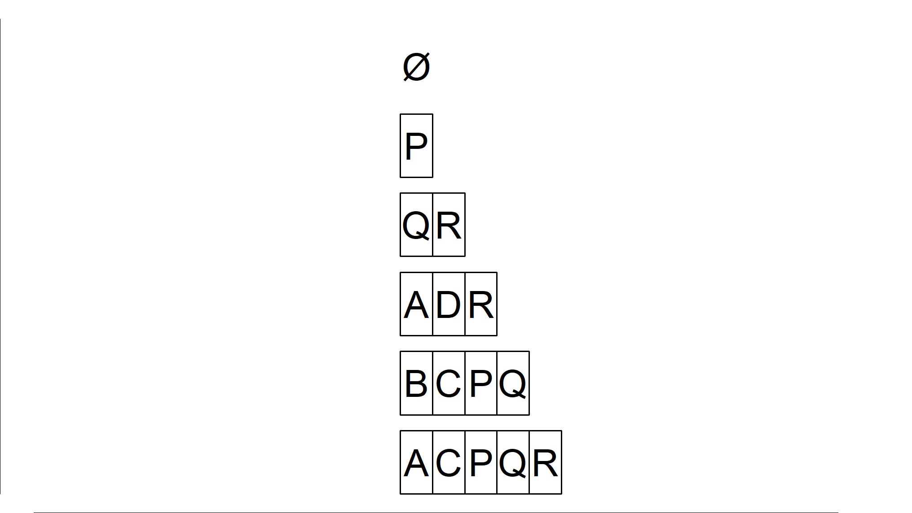
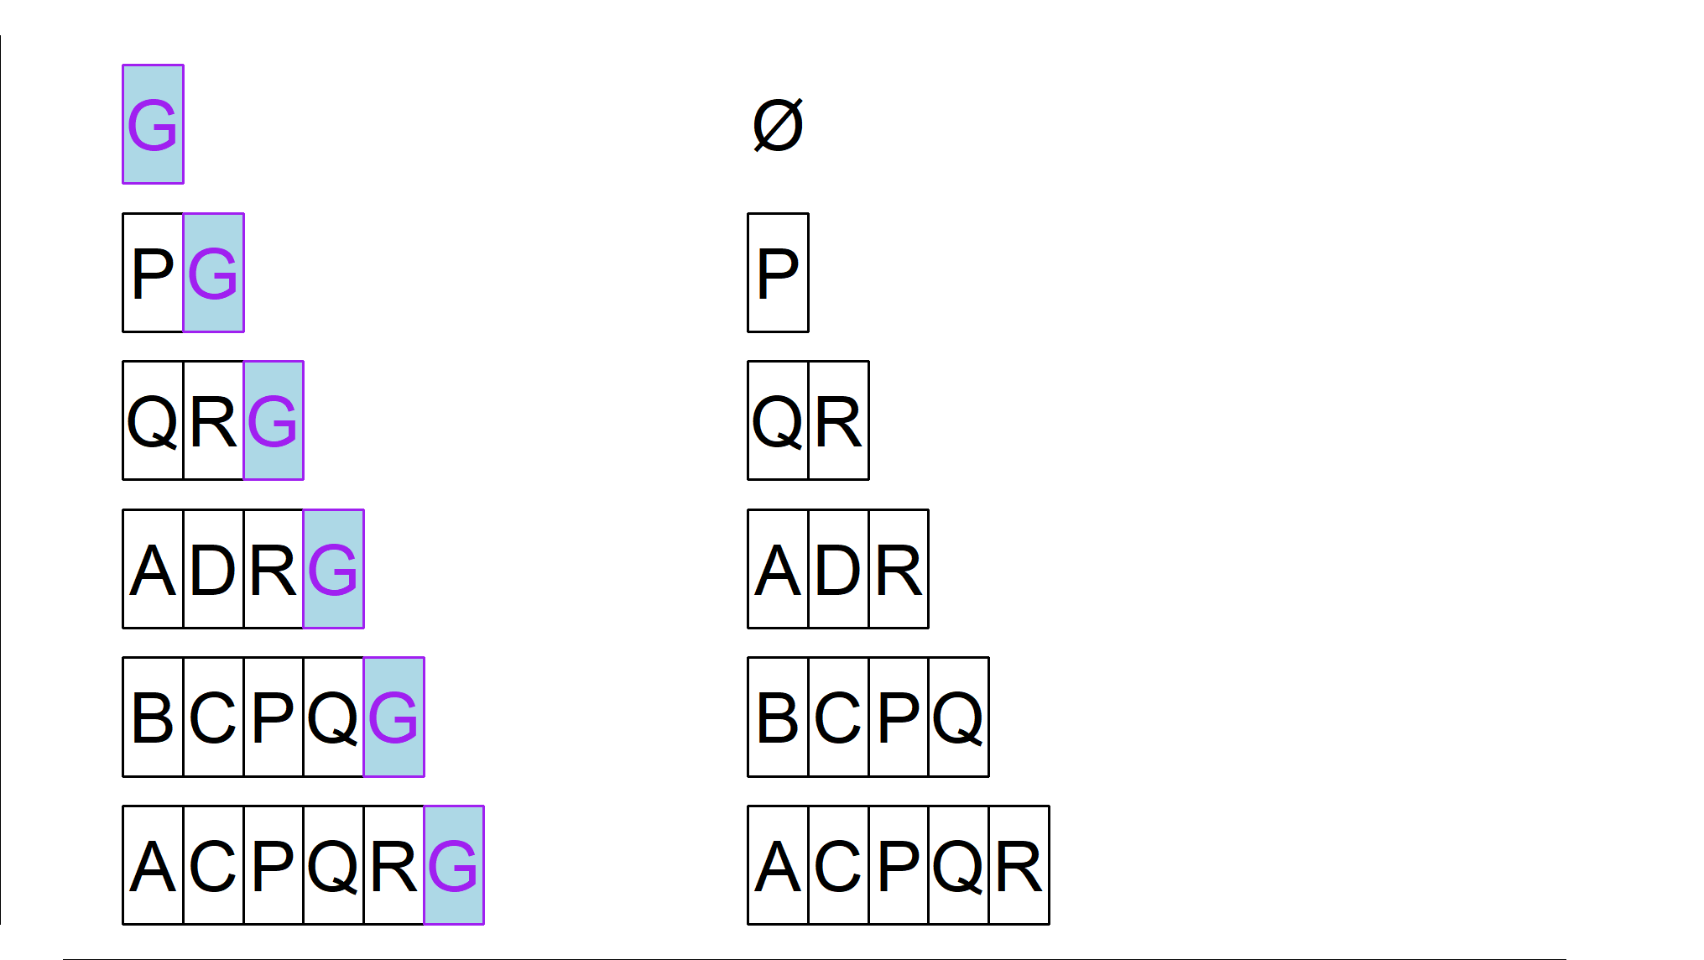
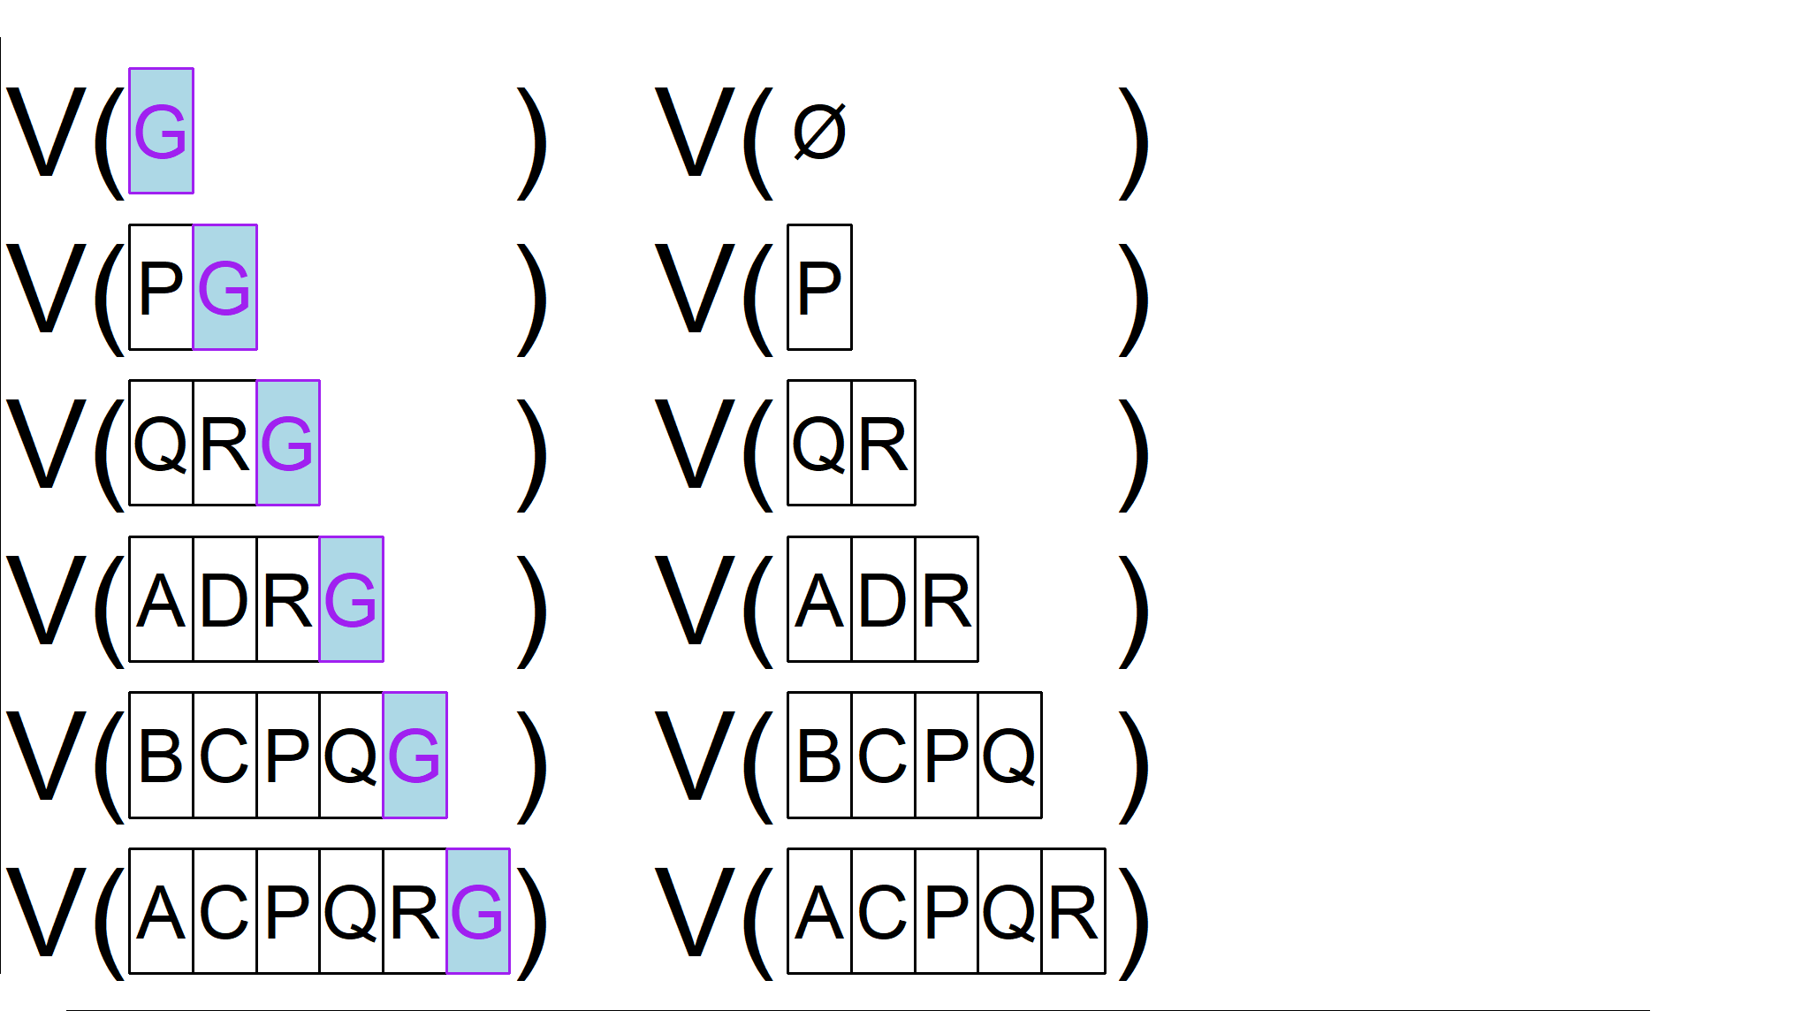
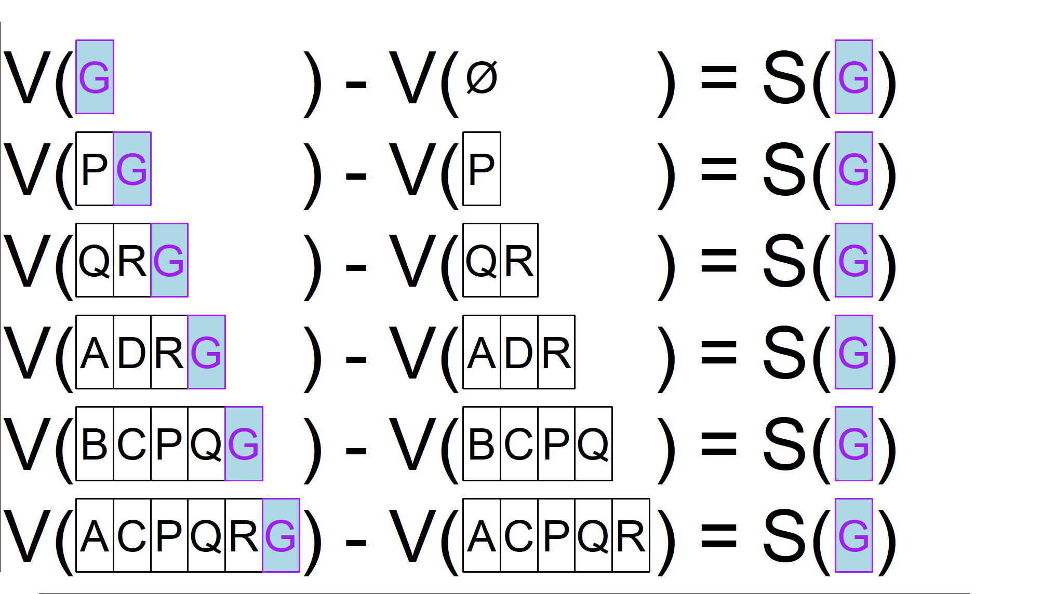
The Combination View
Consider all combinations:
Of every size
That do NOT include G
Add item G to them
Consider all combinations:
Of every size
That do NOT include G
Add item G to them
Compute value of each
Consider all combinations:
Of every size
That do NOT include G
Add item G to them
Compute value of each
Difference in valuation is G’s contribution
Consider all combinations:
Of every size
That do NOT include G
Consider all combinations:
Of every size
That do NOT include G
Add item G to them
Compute value of each
Difference in valuation is G’s contribution
Average contribution over all combos is the SV of G
__________
Average= Shapley Value
Averaged within sizes, then sizes equally
2026 Sawtooth Research Conference Lyon: Shapley Values for Large Problems
Notes:
CSlides.R Saved from Rstudio window as PNG, 1161 x 654
Here, 54% locked, horizontal 4.18” vertical 0.68” from top left

Slide 17
Combination View
Starting combo size
0 1 1 2
Add orange to each:
All combos without orange variable
Added r-squared 0.229 0.056 0.208 0.053
Average added by size 0.229 0.132 0.053
Average of size adds (Shapley Value) 0.138

Slide 18
Weighting Contributions to Combinations for SVs
Each starting combination size is weighted equally
Combinations get equal weight within a size
So, combos are unweighted within a size, and size means are unweighted overall.
Think of orderings–there are many starting with a given item, fewer with a given pair, etc.
Notes:
R: Cslides.R devEMF::emf(height=2.5,width=11)
Here, 91% locked, horizontal 0 vertical 3.27” from top left

Slide 19
Orderings ≡ Combinations
The “average over orderings” view and the “average contribution to a combination” view are algebraically identical.
For intuition, we can use whichever view best fits
Average over orderings is nice for KDRs
Average value of adding to combo is nice for TURF
For computation too, we can use whichever view we like

Slide 20
Shapley Values, Axiomatically
Efficiency: Sum of all SVs is the value of the all-in combination
Symmetry: Identical contributors have identical SVs
Dummy/Null: An item that never adds anything gets an SV of zero
Additivity/Linearity: For any two valuations, the combined SVs
are the sum of the individual ones.
SVs on subgroups can be combined for a total
Or, for random forests, SV is the mean of SVs of the individual trees
Fair: These four are often summarized as a “fair” division of credit
Notes:
Nobel was for “theory of stable allocations and the practice of market design” Nobel 59 years after PhD, Princeton

Slide 21

Shapley Values, Axiomatically
Shapley Values are the only measure that satisfies all 4 key properties:
Efficiency:
Symmetry:
Dummy/Null:
Additivity/Linearity:
Fair:
Notes:
Nobel was for “theory of stable allocations and the practice of market design” Nobel 59 years after PhD, Princeton

Slide 22
Shapley Values
A summary of what’s goes on with combinations of items
Shift focus from combinations (input) to items (much simpler)
Not self-contained, but a “window into” some underlying analysis
Built around some function V of valuing a combination, V (ABC)
In Key Drivers, typically total r-squared of variables in combination
In standard TURF, usually percent of respondents reached
Decompose the value of all items together V(all) into
V(all) = S(A) + S(B) + S(C) + …
where S(X) is the Shapley Value of X

Slide 23

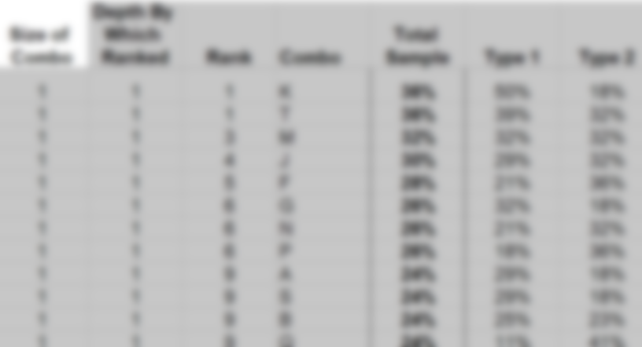
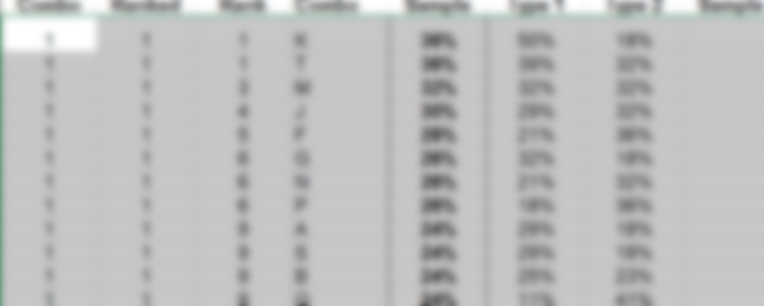
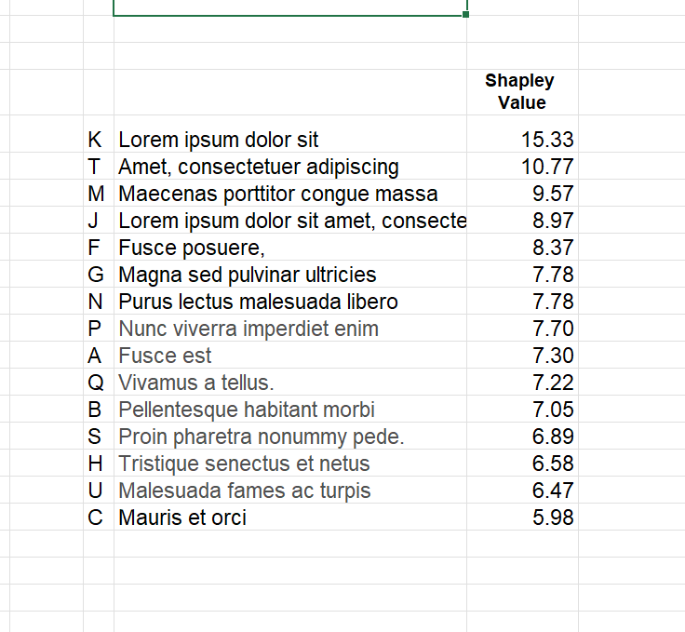
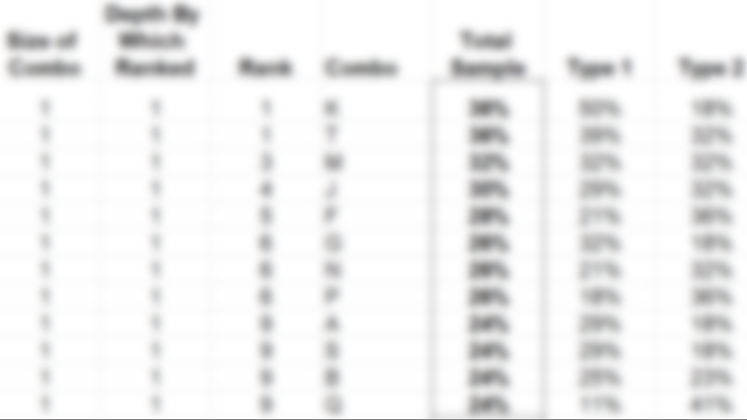
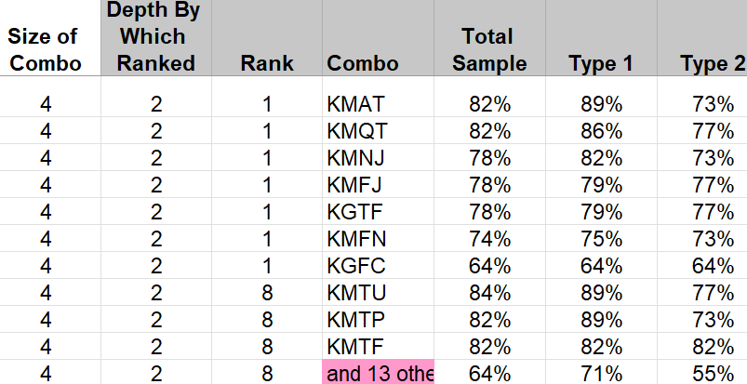
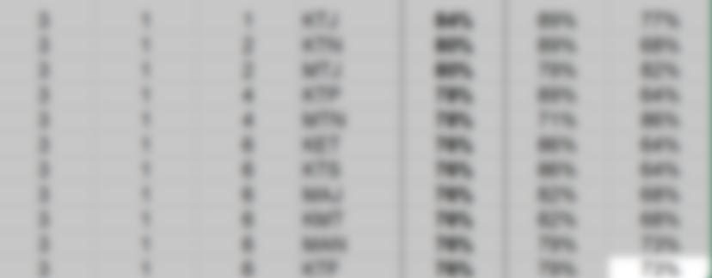
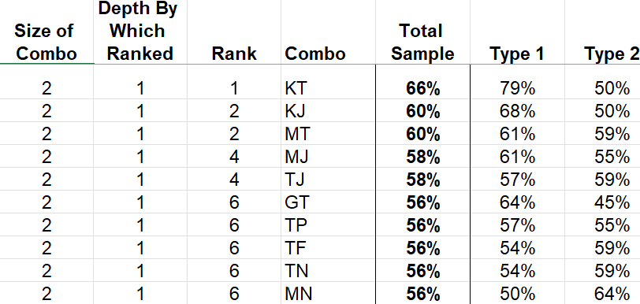
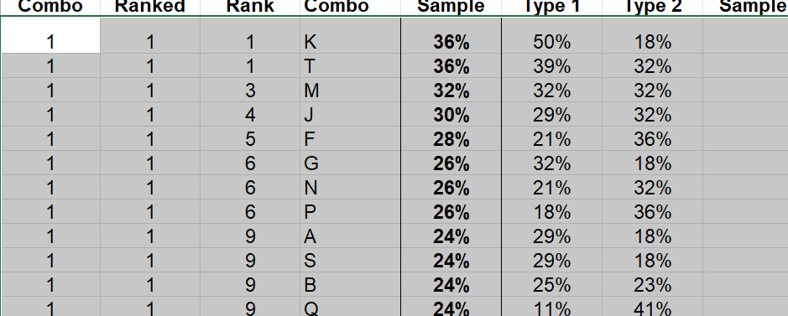
SVs as a “Lens” into TURF
Shapley Values are one value per item
Not endless lists of combinations (and ties)
Room for labels!
Get an AI illustration here …

Slide 24
Component Order of Addition Designs (COAs)

Slide 25
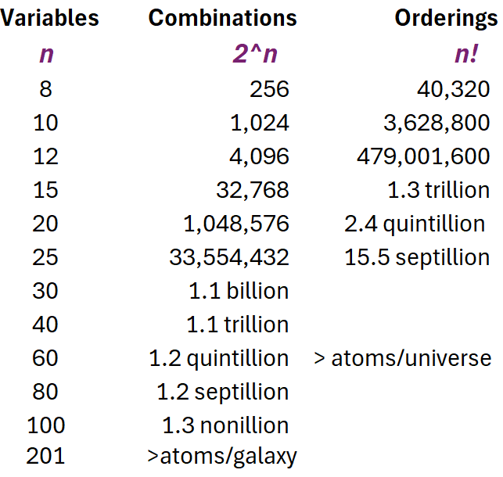
Computation
Combinations work way better than orderings
But both explode rapidly
n = 30 or so is practical limit
Instead: Random sampling!
2026 Sawtooth Research Conference Lyon: Shapley Values for Large Problems

Slide 26
Sampling Combinations?
We could sample combinations
Need samples within each size
Different samples for each item being evaluated
Do-able, but a programming/admin headache
Not obvious how to design/optimize the sampling
Sampling orderings would be more straightforward

Slide 27
Component Order of Addition (COA) Designs
A COA is a set of orderings structured to have:
A relatively small number of orderings: n (n-1) total for n items
Equi-positioning: Every item occurs in every position exactly the same number of times
Pairwise equi-precedence: For any pair of items A and B, A precedes B exactly as often as B precedes A
(J-F. Yang et al 2021, and L. Yang et al 2024)
A “random” but experimentally designed sample of orderings

Slide 28
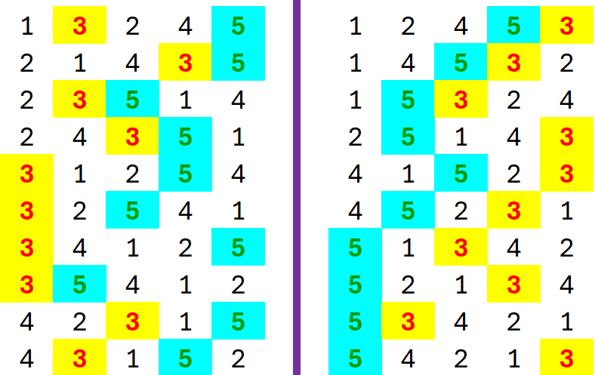
Example: A Small COA
n = 5 items/variables
n (n-1) = 20 orderings
Each item is in each position n-1 = 4 times
For any pair, say 3 and 5, 3 is before 5 10 times, 5 is before 3 10 times
(Orderings sorted to highlight 3/5 pairwise ordering)

Slide 29
But, Do They Work?
Yes, incredibly well
Blue line—dead on!
2026 Sawtooth Research Conference Lyon: Shapley Values for Large Problems
Notes:
Almost all scatterplots: devEMF::emf(width=8), paste here at 77% locked, 3.9“ horizontal and 0.1“ vertical from top left.
Works 1pre.emf
Vs 20 trillion all-orderings

Slide 30
But, Do They Work?
Yes, incredibly well
Blue line—dead on!
Log scale amplifies situation at the bottom
RMS CV is “SD of percent error”
Takes out scale
Comparable across datasets
2026 Sawtooth Research Conference Lyon: Shapley Values for Large Problems
Notes:
Almost all scatterplots: devEMF::emf(width=8), paste here at 77% locked, 3.9“ horizontal and 0.1“ vertical from top left.
Works 1pre.emf

Slide 31
A Bigger KDR
29 variables
Exact Shapleys:
20+ hrs est relaimpo
100 min my code
Approximate:
COA: 265 millisec
Can’t go bigger and still have gold standard exact values
2026 Sawtooth Research Conference Lyon: Shapley Values for Large Problems

Slide 32
TURF as a Special Case—Easy Computation
For TURF on 0-1 item measures and 0-1 final reach per respondent:
Exact computation of SVs is easy for any number of variables
BUT those 0-1 qualifiers exclude most forms of TURF on MaxDiff
See Conklin and Lipovetsky (2013) and Lyon (2018), both in Sawtooth Proceedings, for more details on the “hypergeometric trick” for easy, fast, exact SVs on TURF
This makes TURF a great test case for accuracy of sampling
Gold-standard exact Shapleys are easy, even on big datasets

Slide 33
A Big TURF
66 items
standard TURF
RMS CV < 1/4%
2026 Sawtooth Research Conference Lyon: Shapley Values for Large Problems

Slide 34
A Really Big TURF
216 items
Bandit MaxDiff
Utilities thresholded to make 0/1
RMS CV ~ 0.4%
12 seconds w/ COA
2026 Sawtooth Research Conference Lyon: Shapley Values for Large Problems

Slide 35
Multiple COAs Exist
There are more than one COA of any given size.
n! = n (n-1) (n-2)!
There are (n-2)! COAs for n variables
Exhaustive & mutually-exclusive partitioning of all possible orders
Obtained simply by permuting the last n-2 columns of an initial one
Total Orderings
Number of distinct COAs
Size of smallest/standard COA

Slide 36
Using Multiple COAs—Comparing and Stacking
We can approximate SVs with multiple COAs separately
Yielding estimates of our approximation accuracy
We can stack 2 COAs, for 2 n (n-1) orderings
We can stack m COAs, for m n (n-1) ) orderings
Stacking makes a larger COA
Maintaining equi-positioning and pairwise equi-precedence
Yielding greater precision in estimates

Slide 37
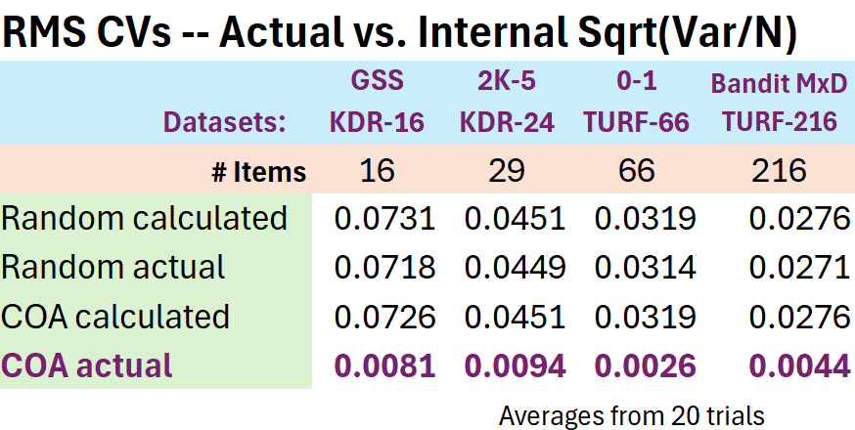
Within COAs, Experimental Design Pays Off
We can calculate SEs using variance across all orderings within a design.
Actual COA accuracy is far better than just SD/sqrt(N)
For random, undesigned, orderings, we get the expected SD/sqrt(N)
Notes:
20X to 150X larger random to perform like a COA

Slide 38
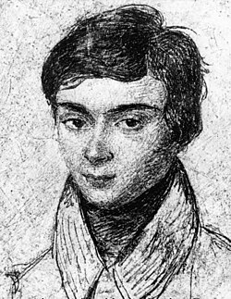
The Fine Print on COAs
COAs come from Galois Orthogonal Arrays
Those exist only for n that is prime or a power of a prime
If our n is not prime or a power, we have to:
Generate a COA for the next larger prime or power
Remove excess items from the orderings
Pretend their r-squared increment or added reach (or whatever) is always zero
Evariste Galois

Slide 39
The Fine Print on COAs
If we remove just one item, we still have equi-positioning
If removing two or more, we lose equi-positioning
But we keep pairwise equi-precedence with any number of removals
Total number of orderings in design does not shrink when items are removed.

Slide 40
Dropped Items by Size
In many cases, not a problem.
Gets worse as size increases.
COA Items Dropped
Notes:
80%, 0.4, 2.3 from emf(width=12,height=4) excess100.emf

Slide 41
How Bad is the Equi-Positioning Imbalance?
Not that bad
Beats random sampling, by far
Measured by CV of the item-by-position counts (0 is perfect)
Worst for small designs where exact computation is feasible anyway
2026 Sawtooth Research Conference Lyon: Shapley Values for Large Problems

Slide 42
When Are Shapley Values Informative?

Slide 43
Do SVs Really Tell Us Anything?
Let’s compare single-item TURF reaches vs. Shapley Values
Or, in KDRs, compare simple correlations with Shapley Values
If highly correlated, SVs aren’t really new information
Which suggests underlying analysis is not really new either
If not so correlated, SVs and underlying analysis give new insights
In this context, super-high correlation is bad

Slide 44
Do SVs Really Tell Us Anything?
SVs clearly reveal a number of strengths hidden in the solo reaches
Rank orders of many items change substantially
Yes, they tell us something
2026 Sawtooth Research Conference Lyon: Shapley Values for Large Problems
Notes:
LearnKU2.emf, 77%, 3.9 0.1 final

Slide 45
Do We Learn From These?
Yes
2026 Sawtooth Research Conference Lyon: Shapley Values for Large Problems
Notes:
Learn4upF.emf, 68%, 1.8 0.6

Slide 46

Do We Learn from This TURF?
Not so much
Lots of local shifts, but nothing exciting overall
In real practice, you
Can always look at such a plot
Decide whether to use SVs or not
Notes:
77%, 3.9, 0.1

Slide 47
When Shapley Values Tell Us Nothing
≡
≡
≡
When SVs align perfectly with solo/univariate item/variable scores,
the way we are valuing combinations is nothing but:
“adding up the pieces” V(ABC) = V(A) + V(B) + V(C)
Then, S(X) ≡ V(X) because V(ABC) = S(A) + S(B) + S(C)
Also true (mostly) when V(ABC) ≅ V(A) + V(B) + V(C)
SVs give us no insight here--there is none (or little) to be had
In other words, “the combination function is not interesting”
Or, “the underlying analysis is not adding anything”
But, the business problem should drive the choice of analysis
When SVs align perfectly with solo/univariate item/variable scores,
the way we are valuing combinations is nothing but:
“adding up the pieces” V(ABC) = V(A) + V(B) + V(C)
Then, S(X) ≡ V(X) because V(ABC) = S(A) + S(B) + S(C)
Also true (mostly) when V(ABC) ≅ V(A) + V(B) + V(C)
SVs give us no insight here--there is none (or little) to be had
When SVs align perfectly with solo/univariate item/variable scores,
the way we are valuing combinations is nothing but:
“adding up the pieces” V(ABC) = V(A) + V(B) + V(C)
Then, S(X) ≡ V(X) because V(ABC) = S(A) + S(B) + S(C)

Slide 48
Size-Limited Shapley Values*
We may have n items, but be interested only in combinations of up to k at a time, k < n or even k << n
So, consider orderings only up to k ^{th} position
Or, combinations only up to size k
We lose the efficiency property
Sum of the size-limited SVs no longer has any special meaning
We potentially gain a lot of business relevance
* Not the same idea as “k -lateral,” “k -additive” or “size-truncated” games or values

Slide 49
Size-Limited SVs and COAs
Size-limited SVs may be feasible using an all-combinations (of up to size k) approach
Also can use just the first k variables in each order from a COA
Same number of total orderings to handle, just each one shorter
For “pure” COAs (i.e., primes and powers), this maintains equi-positioning and equi-precedence
For dropped-variable COAs (including dropping just one), not so
For 0/1 TURF, fast exact hypergeometric calculations still work
Can also impose minimum combo sizes – not clear if that’s useful

Slide 50
Size-Limited SVs Can Be More Interesting
Lower correlations are more interesting
Within reason
More going on with:
Smaller maximum combo sizes
Greater depths of reach
BUT remember the business issue

Slide 51
Size-Limited SVs Can Be More Interesting
Lower=more interesting
But a lot of these get way low.
Again, for more interest:
Smaller maximum combo sizes
Greater depths of reach
AND remember the business issue

Slide 52
TURF on MaxDiff

Slide 53
TURF and MaxDiff
TURF is frequently done on MaxDiff data. Three main options:
Option 1: Pre-thresholding (or “item thresholding”) to make item utilities or scores 0/1 up-front
Option 2: Scores and total scores—”weighted probability” scores/methods
Option 3: Post-thresholding—minimum imposed on total scores

Slide 54
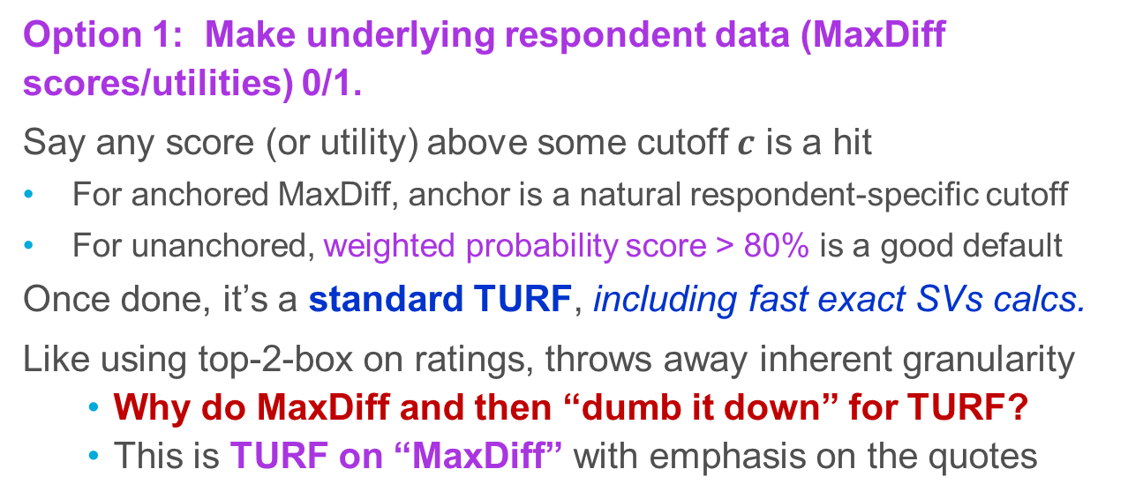
TURF and “MaxDiff” – Opt. 1: Pre-Thresholding
Option 1: Make underlying respondent data (MaxDiff scores/utilities) 0/1.
Say any score (or utility) above some cutoff $c$ is a hit
For anchored MaxDiff, anchor is a natural respondent-specific cutoff
For unanchored, weighted probability score > 80% is a good default
Once done, it’s a standard TURF, including fast exact SVs calcs.
Like using top-2-box on ratings, throws away inherent granularity
Why do MaxDiff and then “dumb it down” for TURF?
This is TURF on “MaxDiff” with emphasis on the quotes

Slide 55
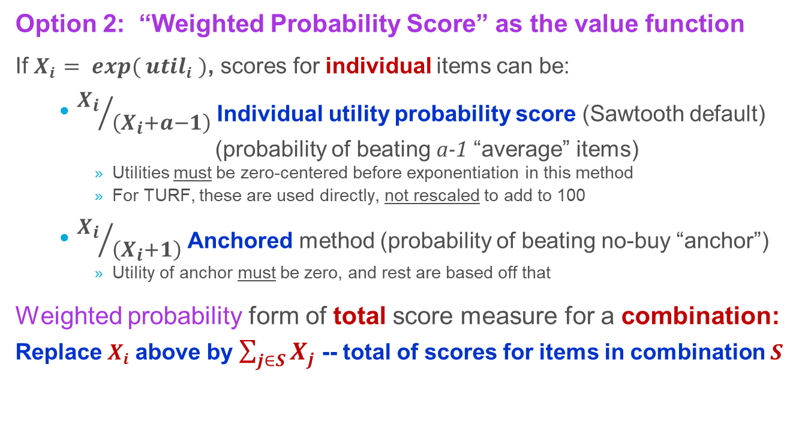
“TURF” & MaxDiff, Opt. 2: Weighted Probability
Option 2: “Weighted Probability Score” as the value function
If $X_{i}$ $= exp⁡( {util}_{i}$ $)$, scores for individual items can be:
${X_{i}}/{\left(X_{i}+a−1\right)}$ Individual utility probability score (Sawtooth default)
(probability of beating a-1 “average” items)
Utilities must be zero-centered before exponentiation in this method
For TURF, these are used directly, not rescaled to add to 100
${X_{i}}/{\left(X_{i}+1\right)}$ Anchored method (probability of beating no-buy “anchor”)
Utility of anchor must be zero, and rest are based off that
Weighted probability form of total score measure for a combination:
Replace $X_{i}$ above by $\sum_{j∈S}{X_{j}}$ -- total of scores for items in combination S

Slide 56

MaxDiffs by Weighted Prob Scores
(Sawtooth Default)
Very little going on here
Scores can’t be very far from additive
Notes:
MD2ana.emf

Slide 57
MaxDiffs by Weighted Anchor Scores
(default when anchored)
Still not much going on to right →
Both at bottom look good
Anchors hard to beat on bottom 2; easy at top right
Notes:
MD2aanch.emf

Slide 58
“TURF” and MaxDiff, Weighted Probability
Option 2: “Weighted Probability” as the value function
The verdict:
Weighted Anchor sometimes added insight beyond item scores
The unanchored default Weighted Probability Score did not
At least on these datasets
WPS preserves MaxDiff granularity, but loses TURF “reach threshold”
This is “TURF” on MaxDiff, emphasis again on the quotes

Slide 59
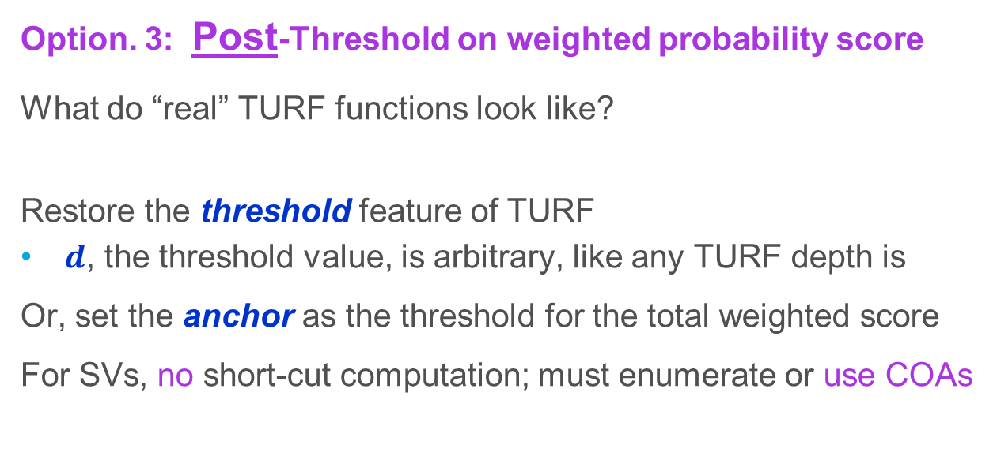
TURF and MaxDiff, Opt. 3: Post-Thresholding
Option. 3: Post-Threshold on weighted probability score
What do “real” TURF functions look like?
Restore the threshold feature of TURF
$d$, the threshold value, is arbitrary, like any TURF depth is
Or, set the anchor as the threshold for the total weighted score
For SVs, no short-cut computation; must enumerate or use COAs
Like this:

Slide 60
Choosing a Post-Threshold Value
For Multinomial Logit (MNL) Scores, we will try 0.5
Combination is more likely to be chosen than combo of all others
For standard Weighted Probability Score, we will use 0.9
Implies high probability (90%) of winning against a few “average items”
For Anchored Weighted Probability Score, we will use 0.5
Implies the combination will “beat” the anchor
All are ultimately arbitrary choices; not claimed to be best choices

Slide 61
MaxDiffs by Post-Thresholded MNL>0.5 Scores
Minimal signs of life here
Is >0.5 the right cutoff?
(Implies combin-ation beats all left out)
Notes:
MD3ana4.emf

Slide 62
MaxDiffs by Post-Thresholded
Weighted Probability Scores >0.9
Not bad overall
Way more interesting than the MNL version
Notes:
MD3cna.emf

Slide 63
MaxDiffs by Post-Thresholded
Anchor Weighted Prob. Scores
Lots of interesting things here with hard-to-beat anchors
Not so much with the Anchored-90 study (top right) (an easy anchor)
Notes:
MD3canch.emf

Slide 64
TURF and MaxDiff—Where Did SVs Help?
TURF is frequently done on MaxDiff data. Three main options:
Option 1: Pre-thresholding to make item 0/1
Arbitrary cutoff
Option 2: Scores and total scores—”weighted probability” scores/methods
Sawtooth default (score vs. a average items)
Anchor scoring (probability of beating anchor)
Option 3: Post-thresholding—minimum imposed on total scores
MNL, arbitrary cutoff (say 0.5)
Sawtooth default, arbitrary cutoff (say 90%)
Anchored, arbitrary (say >50% beats anchor)
TURF, but not much like MaxDiff
TURF on “MaxDiff”
Anchor as the cutoff
MaxDiff, but not much like TURF
”TURF” on MaxDiff
Key parts of both
TURF on MaxDiff

Slide 65

TURF and MaxDiff—Where Do SVs Help?
Recall Shapley Values as a lens into what’s going on.
When they don’t help, it’s because nothing much is going on …
… beyond the simple univariate/solo item scores/contributions
It’s the underlying analysis, not the SVs, that isn’t adding anything
STILL, the business problem should drive the underlying analysis
Not the degree of technical interest in the results

Slide 66
Wrapping Up

Slide 67
Many Ways to Use Shapley Values
“Contribution” attribution within a chosen subset
Importance/simplification of a large set of items is obvious
Prune/pre-select items for exhaustive searches
Any time a simple and “fair” summary of items/variables is needed
Simple to present and explain; not unstable over time/subgroups
Fairly simple to compute
Fair both in one strict mathematical sense, and also intuitively

Slide 68
Many Ways to Value Combinations
Key Drivers, for importance of all, or contributions within a subset
Adjusted r ² as well as straight r ²
Logistic regression as well (LL improvement instead of r ²)
Discriminants, MNLs, Trees and Random Forests (RLH or hits)
TURF, in many variants
On MaxDiff, in ways discussed
Multiple depths of “reach”
With alternatives other than “reach” (Lyon 2018, Conklin & Lipovetsky 2013)
ANY problem of valuing combinations/bundles of ANY thing(s)

Slide 69
Exact & Fast SVs with TURF Variants
“Hypergeometric trick” can be extended to many variations:
Reach -- as in standard TURF, but any depth d
Coverage – Must include all “hits”, or miss at most d of them
Majority – Combos must include more “hits” than “misses”
Non-excess – Combos must include only “hits”, or at most d “misses”
Partial Credit – Each hit counts 1/3 (say) up to maximum of 1 total
Size-Limited Combinations – as mentioned earlier
All still fast, exact and scalable
See Lyon (2018, Sawtooth Proceedings) for details and more suggestions

Slide 70
Software & Design Catalog
R package ShapCOA to handle all SV and TURF issues discussed:
Free and publicly available at github.com/DWLyon17/ShapCOA
Many details in Appendix slides
A catalog of COA designs for all numbers of items from 4 to 227
As CSV files, usable anywhere, not dependent on R
One COA per number of items
Free and publicly available at github.com/DWLyon17/COAdesigns
Sawtooth Software is implementing COAs and other new features for their TURF on MaxDiff capabilities

Slide 71
Take-Aways: Shapley Values
Intuitive – all orderings, average contribution, “fairness”
Useful – compact and insightful; more stable in comparisons
Easy – At least in small problems and most 0/1 TURF-like situations
COAs make even large problems feasible, with high accuracy
Evaluate SVs vs. univariate scores to see if value really added
For MaxDiff, consider post-thresholding approaches
Consider using size-limited “SVs” on smaller combinations
Be inventive in ways to value combinations
Notes:
2018 leftover – need to merge with next, and tie back to rest

Slide 72
Discussion

Slide 73
References
Conklin, Michael and Stan Lipovetsky (2013), “The Shapley Value in Marketing Research: 15 Years and Counting,” Proceedings of the 2013 Sawtooth Software Conference.
Johnson, Jeff and James Lebreton (2004), “History and use of relative importance indices in organizational research,” Organizational Research Methods, volume 7, issue 3 (July 2004), pp. 238-257.
Kruskal, William (1987), “Relative Importance by Averaging over Orderings,” The American Statistician, volume 41, issue 1 (February 1987), pp. 6-10.
Lyon, David W. (2018), “Shapley Values: Easy, Useful and Intuitive,” Proceedings of the 2018 Sawtooth Software Conference.
National Opinion Research Center (2024), The General Social Survey, https://www.norc.org/research/projects/gss.html
Toubia, Olivier, George Gui, Tianyi Peng, Daniel Merlau, Ang Li and Haozhe Chen (2025), “Database Report: Twin-2K-500: A Data Set for Building Digital Twins of over 2,000 People Based on Their Answers to over 500 Questions,” Marketing Science, volume 44, number 6 (November-December 2025), pp. 1446-1455.

Slide 74
References (continued)
Yang, Liuqing, Yongdao Zhou, Haoda Fu, Min-Qian Liu and Wei Zheng (2024), “Fast Approximation of the Shapley Values Based on Order-of-Addition Experimental Designs,” Journal of the American Statistical Association, volume 119, issue 547 (September 2024), pp. 2294-2304
Yang, Jian-Feng, Fasheng Sun and Hongquan Xu (2021), “A Component-Position Model, Analysis and Design for Order-of-Addition Experiments,”, Technometrics, volume 63, issue 2 (May 2021), pp. 212-24.

Slide 75
Appendix A:
R Software and
Design Catalog

Slide 76
R Software—COA Creation
Will generate COAs
Including multiples at a time, stacked or separate
Including dropping of variables for non-prime-power sizes
Will size, check, reduce, permute and stack COAs
Those are all incorporated in generating them too
Will also generate purely random, cyclic, Williams or all orderings
GitHub site also includes a “design catalog”
Pre-generated COAs for every size from 4 to 200

Slide 77
R Software—General Shapley Values
Includes drivers to compute Shapley Values
Using all-combinations-based approach (smaller problems only)
Using orderings approach (i.e., COAs or any other orderings)
Using any valuation function (bring your own) in R or C++

Slide 78
R Software—Key Driver Regressions
Pre-written driver/valuation combinations (highly optimized C++)
Linear Key Driver Regressions:
For either straight r-squared or adjusted r-squared, or both
For multiple dependent variables at once
Using either all-combinations or sampled-orderings (COAs)
Logistic KDRs (much slower) (orderings-based only; 1 DV only)

Slide 79
R Software—TURF
Pre-written driver/valuation combinations (highly optimized C++)
TURF (orderings-based only):
For typical 0/1 problems with any “depth”
For weighted probability MaxDiff scores: MNL, Sawtooth or anchored
For post-thresholding on weighted prob scores
For variants other than “reach” (see Lyon 2018)

Slide 80
R Software—TURF
Exact fast Shapley Values with “hypergeometric trick” (0/1) (see Lyon 2018)
For not-too-large numbers of items:
Full TURF analysis, any depth, and for non-reach variants as well (see Lyon 2018)
Shapley Values from results (for all combos) from any source
Find best combinations, by full search, by stepwise or by top Shapley values
Notes:
Review all routines for other features worth mentioning

Slide 81
R Software—Other
The following may not be immediately available but will be added:
Support for respondent weights in all cases
Support for parallelization, either to split very-large orderings sets or to use multiple COAs to assess estimation accuracy simultaneously
Support for size-limited Shapley Values in all routines (some functions now support them, but not all)
Notes:
Review all routines for other features worth mentioning

Slide 82
GitHub for R Software & Design Catalog
R package ShapCOA with all the functions just mentioned
Free and publicly available at github.com/DWLyon17/ShapCOA
A catalog of COA designs for all numbers of items from 4 to 225
As CSV (Excel, ASCII) files, usable anywhere, not dependent on R
One COA per number of items
Free and publicly available at github.com/DWLyon17/COAdesigns

Slide 83
Other Software
R package relaimpo (“relative importance”) handles linear KDRs
Its default lmg option is for Shapley Values (much slower than ShapCOA)
Its genizi option produces Johnson’s Relative Weights Analysis (RWA)
Several other r-squared dividing options are also offered
Uses an all-combinations approach for Shapley Values, so 25 items or so is the largest feasible problem. Most other options are very fast.
Can handle variable groups, treating all dummy vars from one question as a single entity, for example. Can force some variables always-in.
Includes plotting and bootstrapping options
Does not handle adjusted r-squared, multiple dependents or non-linear models

Slide 84
Appendix B:
Software Timings

Slide 85
Timing Considerations – All COAs
All COA-based approaches include an n^3 (n-cubed) component:
Orderings in a COA: n ( n – 1 )
Length of each ordering: n
For size-limited Shapley Values, the last n becomes k, maximum combination size considered
If COAs are stacked, the number stacked enters into things, linearly
Generating COAs, in R, on the fly, is also an n^3 process
But only 0.5 second even for a 200-item COA
Notes:
Include 203-variable KDR, 70-variable logistic regression, relaimpo plus mine, etc., etc.
Observe KDRs are n^5 problem, TURFs are n^3 (unless the hypergeometric trick works)

Slide 86
Timing Considerations – Timing Charts
Following graphs for each type of problem show actual timing trials
Note log scale on vertical (time) axis
Timed on an Intel Core i7-8750H CPU @ 2.2GHz
(a 2018-vintage laptop)
Under Windows 10, R 4.5
With R using the Intel MKL (Math Kernel Library)
Without any use of parallel processes or multi-threading except as builtin to R or MKL.
Notes:
Include 203-variable KDR, 70-variable logistic regression, relaimpo plus mine, etc., etc.
Observe KDRs are n^5 problem, TURFs are n^3 (unless the hypergeometric trick works)

Slide 88
Timing Considerations – TURFs
All COA-based approaches include an n^3 (n-cubed) component
TURF computations do depend on N, number of respondents
But only linearly
And no extra complexity per ordering or per evaluation
So O ( N n^3 ) net
But only for weighted-probability, non-pre-thresholded MaxDiffs
For 0-1 TURF, hypergeometric exact time is trivial
Includes pre-thresholded MaxDiffs
Show specific numbers
Notes:
Include 203-variable KDR, 70-variable logistic regression, relaimpo plus mine, etc., etc.
Observe KDRs are n^5 problem, TURFs are n^3 (unless the hypergeometric trick works)

Slide 89
Number n of Items

Slide 90
Times jump about 50% when N n (respondents times items) exceeds 250,000, presumably due to CPU caching limits
Number N of Respondents

Slide 91
Timing Considerations – Linear KDRs
All COA-based approaches include an n^3 (n-cubed) component
Linear KDRs manipulate a n^2 variance-covariance matrix
Net result: linear KDRs with COAs time requirements are O ( n^5 )
Number of respondents N does not matter
Except trivially in one-time construction of the var-covar matrix
R package relaimpo uses an all-combinations approach,
so O ( 2^n n^3 )
Notes:
Include 203-variable KDR, 70-variable logistic regression, relaimpo plus mine, etc., etc.
Observe KDRs are n^5 problem, TURFs are n^3 (unless the hypergeometric trick works)

Slide 92
Notes:
91%, 0, 0

Slide 93
Timing Considerations – Logistic Regressions
All COA-based approaches include an n^3 (n-cubed) component
Logistic Regressions do depend on N, number of respondents
But only linearly
Also have to solve for up to n parameters in each regression
Partly avoided by using each step’s result at starting estimate for next
Seems not to affect number of ML iterations very much
So O ( N n^3 ?) net. Data actually shows O ( N n^4)
Aside from the order, logistics are inherently much slower to run
Notes:
Include 203-variable KDR, 70-variable logistic regression, relaimpo plus mine, etc., etc.
Observe KDRs are n^5 problem, TURFs are n^3 (unless the hypergeometric trick works)

Slide 95
Appendix C:
Johnson’s Relative Weights Analysis

Slide 96
Johnson’s Relative Weights Analysis
x
Johnson’s RWA: a totally different approach to dividing r-squared
For linear Key Driver Regressions only
Different theory, but results fairly close to Shapley Values
Shares “efficiency” and “dummy/null” properties of SVs
Very fast to compute, even for large problems
All just linear algebra
50 millisec for 203 variables (vs. 23.5 mins COA that size)
Good enough to substitute for Shapley Values?

Slide 97
Johnson’s Relative Weights Analysis
x
For 16-variable KDR, both look “pretty good”
But note 9::1 difference in RMS CVs
General Social Study, 16-Item KDR

Slide 98
x
Johnson’s Relative Weights Analysis
Differ-ences on these two are large
RWA RMS CVs ~20X COA’s
2K-500 24- & 29-KDRs

Slide 99
x
Johnson’s Relative Weights Analysis
For larger KDRs, no exact Shapley Values
But we know COA approximations are highly accurate
And Johnson’s RWAs don’t match that well

Slide 100
Johnson’s Relative Weights Analysis
Good enough to substitute for Shapley Values?
Speed is a major advantage
SEs/CIs are directly estimable (no bootstrapping) (don’t ask me how)
Explanations can be harder:
Need to explain the linear algebra?
How explain (significant) differences vs. Shapley Values?
Limited to r-squared in linear KDRs
Not adjusted r-squared
Not log-linear KDRs, not TURFs, not anything else
Maybe!
Maybe not

